Slide 1
Chapter 12
Congress
American Democracy Now, 7th edition
Brigid Callahan Harrison
Jean Wahl Harris
Michelle D. Deardorff
Copyright 2022 © McGraw Hill LLC. All rights reserved. No reproduction or distribution without the prior written consent of McGraw Hill LLC.

Slide 2
The Origins of Congress 1
In structuring the Congress, the framers strove to create a legislative branch that was powerful enough to govern and to check the power of the president, and yet not so powerful that the legislature itself would exercise tyrannical rule.
Constitution created a bicameral, or two-house, legislature in which one house, the House of Representatives, would be based on population, and the other chamber, the Senate, would be based on state representation.

Slide 3
The Origins of Congress 2
House of Representatives, with the smallest constituencies of any federal office (currently about 711,000 people reside in each congressional district), is the chamber closer to the people.
Framers conceived the Senate to be a more elite, more deliberative institution, one not subject to the whims of mass politics like its lower-house counterpart.

Slide 4
Congressional Elections
House members are elected every two years, in even-numbered years.
Framers sought to check the power of the people, so members of the Senate originally were chosen by state legislators.
Ratification of the Seventeenth Amendment in 1913 shifted the election of senators to popular election within the states.
Senators serve six-year terms, staggered so that one-third of the Senate is elected every two years.

Slide 5
Incumbency
Why do incumbents so often win reelection?
Stronger name recognition.
Easier access to media coverage.
Redistricting that favors the incumbent party.
Franking—free mailing privilege.
Campaign contributions.
Casework.
Incumbent quality.

Slide 6
Reapportionment and Redistricting
Reapportionment is the reallocation of seats in the House of Representatives on the basis of changes in a state’s population since the last census.
Redistricting, the redrawing of congressional district boundaries within a state, is based on the reapportionment from the census.
Greatest shifts in House composition occur in the first election after reapportionment and redistricting.
2002, 2012, and so on.

Slide 7
Gerrymandering
Redrawing of congressional boundaries for the purpose of political advantage is a form of gerrymandering, the practice of drawing legislative district boundaries to benefit an incumbent, a political party, or some other group.
Most forms of gerrymandering are legal.
U.S. Supreme Court ruled in 1986 that a gerrymandering plan is unconstitutional only when it eliminates the minority party’s influence statewide.

Slide 8
Increased Partisanship and Congressional Redistricting
In earlier times, redistricting occurred through a simple redrawing of the lines of a congressional district to accommodate population changes.
Today, computer-driven mapmaking technology helps configure districts to ensure a “safe seat.”
Representatives from many of these safe seats can act in a partisan manner with impunity.
In contrast, when congressional districts are more competitive, a House member typically would have to temper his or her partisan impulses.

Slide 9
Majority-Minority Districts
Majority-minority district is composed of a majority of a given minority community—say, African Americans—and the creators’ intent is to make it likely that a member of that minority will be elected to Congress.
Supreme Court has ruled that such racial gerrymandering is legal unless the state legislature redrawing the district lines creates majority-minority districts at the expense of other redistricting concerns.

Slide 10
Powers of Congress
Primary source of congressional authority is the U.S. Constitution.
Constitution enumerates to Congress a number of different powers.
Necessary and proper—or elastic—clause has also allowed Congress to legislate in many matters not described in the enumerated powers.
In addition to the Constitution, Congress derives power from Supreme Court decisions, the media, and the people.

Slide 11
Table 12.1 Enumerated Powers of the Congress
TYPE OF POWER | DESCRIPTION
Judicial Powers | Establish the federal court system, Punish counterfeiters, Punish illegal acts on the high seas, Impeach the president, vice president, and federal judges
Economic Powers | Impose taxes, Establish import tariffs, Borrow money, Regulate interstate commerce, Coin and print money, determine the value of currency
National Security Powers | Declare war, Raise and regulate national armed forces, Call up and regulate state national guard, Suppress insurrections, Repel invasions
Regulatory Powers | Establish standards of weights and measures, Regulate copyrights and patents
Administrative Powers | Establish procedures for naturalizing citizens, Establish post offices, Govern the District of Columbia
Table summarizes enumerated powers of the Congress. The column notes judicial powers, economic powers, national security powers, regulatory powers, and administrative powers.

Slide 12
Functions of Congress
Constitution is far more explicit in defining the responsibilities of the national legislature than it is in describing the function of the other branches of the government.
In its shaping of congressional functions, the Constitution’s concerns with limited government, checks and balances, the separation of powers, and the creation of a federal system are all readily apparent.

Slide 13
Representation Comes in Many Forms
Representation traditionally involves a House or Senate member’s articulating and voting for the position that best represents the views of his or her constituents.
Sometimes a member of Congress speaks for other constituencies as well.
Often, Congress’s policy-making function is at odds with its representation function.

Slide 14
Models of Representation
Trustee model: a legislator follows his or her own conscience about issue positions and how to vote.
Instructed delegate model: a legislator votes in keeping with the constituents’ views, even if those views contradict the legislator’s personal views.
Most analyses of representation indicate that legislators are likely to combine these approaches in a hybrid model, called politico.

Slide 15
Pork Barrel and Earmarks
Members of Congress also represent their constituencies through pork barrel politics.
Pork barrel refers to legislators’ appropriations of funds for special projects located within their congressional districts.
Members of Congress also use earmarks as a means of representing constituent interests.
Earmark: a designation within a spending bill that provides for a specific expenditure.

Slide 16
Casework
Casework involves providing representation in the form of personal aid to a constituent or a group of constituents, typically by getting the government to do something the constituent wants done.
In doing so, the member serves in the capacity of an ombudsperson, an elected or appointed representative who acts as a citizens’ advocate.

Slide 17
Policy Making: A Central Responsibility
Policy making function is the central responsibility that the Congress carries out, and nearly all its other functions are related to its policy-making role.
Congressional policy-making power also extends to the operations and priorities of governmental departments and agencies.

Slide 18
Oversight: A Check on the Executive Branch
Congressional oversight is the process by which Congress “checks” the executive branch to ensure that the laws Congress passes are being administered in keeping with legislators’ intentions.
In carrying out their oversight function, members of Congress use a variety of tools:
Congressional hearings.
Confirmation hearings.
Investigations.
Budgetary appropriations.

Slide 19
Agenda Setting and Civic Engagement
Congress engages continuously in agenda setting: determining which public policy issues the federal legislature should consider.
In setting the national agenda, Congress serves as a key agent in molding the scope of civic engagement and discourse, as people learn about, discuss, and form positions about issues.
Frequently, agenda setting is itself influenced by public discourse.

Slide 20
Managing Societal Conflict
Congress also has a significant influence in managing the societal conflict inherent in a divided society such as the United States.
Examples of conflict:
Higher wages versus “pro-business” policies.
Policies that benefit rural areas versus those that benefit urban areas.
Money for seniors; money for children’s programs.
Pro-life versus pro-choice.

Slide 21
The House and the Senate Compared 1
Constitution empowers the House of Representatives, as the legislative body closer to the people, with initiating any bills that result in taxes.
It empowers the Senate, as the more deliberative house, to give the president advice and consent on appointments and the ratification of treaties.
Electoral and legislative structures are also sources of differences between the two houses.

Slide 22
The House and the Senate Compared 2
Differing length of representatives’ and senators’ terms of service affects how members of each chamber of Congress relate to their constituents.
Although the House and the Senate differ in their constitutionally determined duties, both must pass any piece of legislation before it can become law.
Larger size of the House of Representatives, with its 435 members, necessitates a more formal legislative structure to prevent unruliness.

Slide 23
Table 12.2 Differences between the House and the Senate
HOUSE | SENATE
Larger (435 members) | Smaller (100 members)
Shorter electoral cycle (2-year term) | Longer electoral cycle (6-year term)
Narrow constituency (congressional districts) | Broad constituency (states)
Less prestigious | More prestigious
Originates all revenue bills | Ratifies treaties; confirms presidential nominees
Less reliant on staff | More reliant on staff
Power vested in leaders and committee chairs | Power distributed more evenly
Table divided into 2 columns summarizes differences between the house and the senate. The column headers are marked as: House and senate.

Slide 24
The Legislative Process
Bill: a proposed piece of legislation.
There are five steps to a bill becoming law:
Introduction.
Committee review.
House and Senate approval.
Conference committee reconciliation.
Presidential approval.

Slide 25
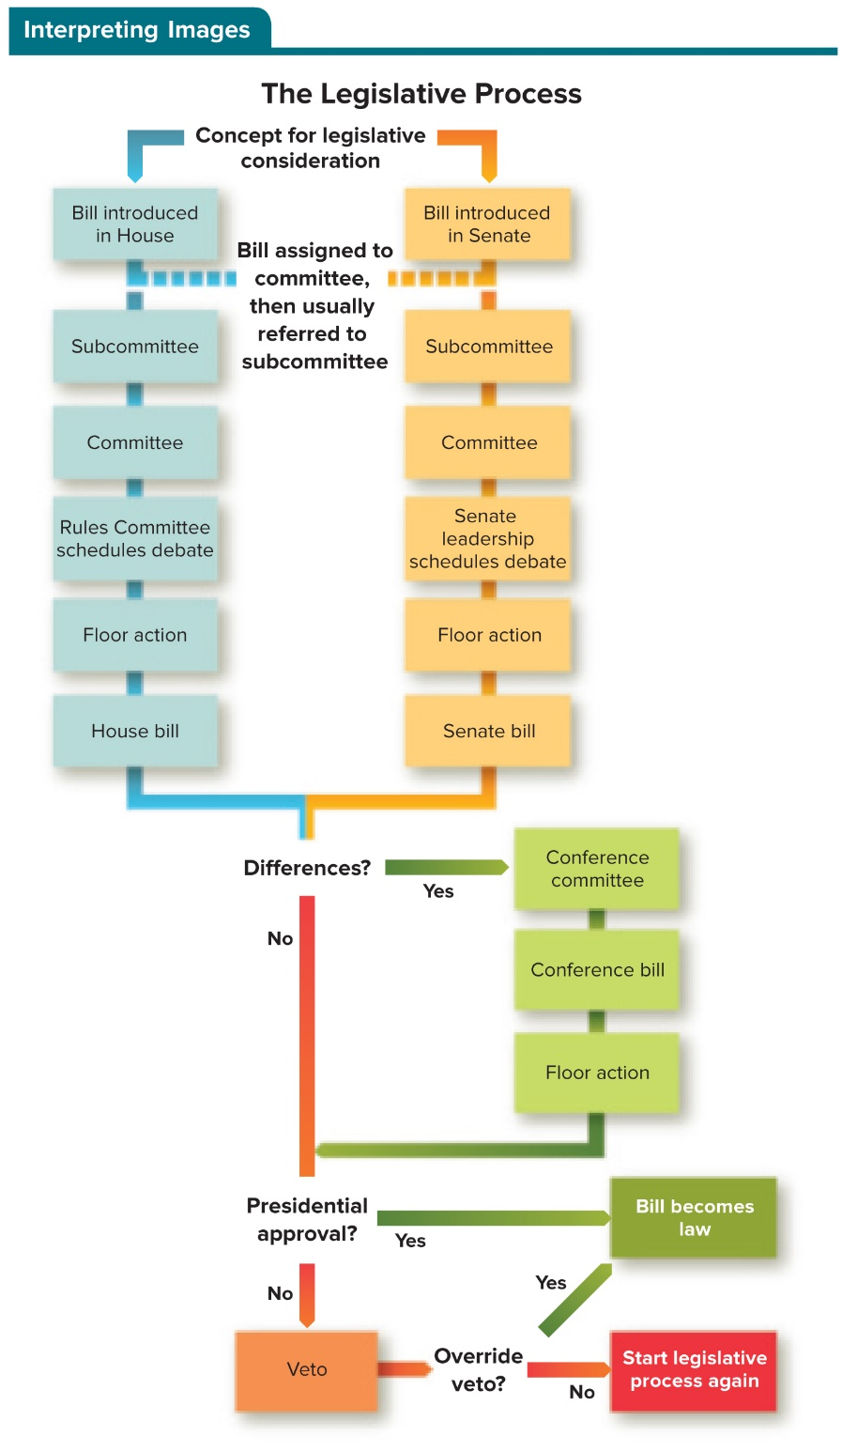
Figure 12.1 The Legislative Process
Access the text alternative to slide image.

Slide 26
Introducing a Bill
In the House of Representatives, a member of a legislator’s staff drafts the proposed legislation, and the House member puts the bill into a wooden box known as the hopper, which is found on a desk at the front of the House of Representatives.
In the Senate, submitting a bill is less formal: It is announced in a speech on the Senate floor; or a written draft is submitted to the Senate clerk; or an amendment to an existing bill being considered may be offered.

Slide 27
The Bill in Committee 1
Most bills that are introduced “die” in committee.
Committee chairs are often chosen using the seniority system, by which the member with the longest continuous tenure on a standing committee receives preference when it chooses its chair.
Standing committees are permanent committees with a defined legislative jurisdiction.
House and Senate each have 20.
Parties in each chamber decide members’ committee and subcommittee assignments.

Slide 28
The Bill in Committee 2
Select committee: specially created to consider a specific policy issue or to address a particular concern.
Joint committee: composed of members from both chambers.
Subcommittee: a subordinate committee in Congress that typically handles specific areas of a standing committee’s jurisdiction.
House has 102; Senate has 67.

Slide 29
The Bill in Committee 3
When a committee or a subcommittee favors a measure, it usually takes four actions:
Agency review: executive agencies are asked for comment.
Hearings: gather information and views from experts.
Markup: suggested changes and amendments.
Report: an explanation to the full chamber of a bills intent.
In the House of Representatives, a special measure known as a discharge petition is used to extract a bill from a committee to have it considered by the entire House.

Slide 30
Debate on the House and Senate Floor 1
If a House bill is “discharged,” or makes it out of committee, it goes to the Rules Committee.
Rules Committee decides on the length of debate and the scope of amendments that will be allowed on a bill.
Senate’s small size allows members to agree to the terms of debate through unanimous consent agreements.

Slide 31
Debate on the House and Senate Floor 2
If the Senate does not reach unanimous consent, the possibility of a filibuster arises—a procedural move that attempts to halt passage of the bill.
Filibusters can be ended by a vote of cloture: a supermajority of 60 senators agree to end debate.
Nuclear option: a maneuver exercised by the presiding officer that eliminates the possibility of filibusters by subjecting votes on certain matters to a simple majority vote.

Slide 32
Debate on the House and Senate Floor 3
If the House and the Senate pass dissimilar bills on the same topic, they are sent to a conference committee for reconciliation.
Conference committee: a bicameral, bipartisan committee whose job is to create a compromise version of bills.
After the committee develops a reconciled version of the bill, it goes back to both chambers for a final vote.

Slide 33
Presidential Action
When both the House and the Senate manage to pass a bill in identical form, it proceeds to the president, who may take one of three actions.
Sign the bill: the bill becomes a law.
Take no action:
If Congress is in session, the bill becomes law after 10 days.
If Congress has adjourned, the bill dies in a pocket veto.
Veto it and return it to Congress: Congress can override the veto with a two-thirds vote.

Slide 34
Table 12.3 Differences in the Legislative Process in the House and Senate
HOUSE | SENATE
Bill introduced by member placing bill in hopper | Bill introduced by member
Relies on Rules Committee to schedule debate on House floor and to establish rules for amendments | Relies on unanimous consent agreements to determine rules for debate and amendments
Has a rule barring nongermane amendments | No rule banning nongermane amendments
Does not allow filibusters | Allows filibusters
Discharge petition can be used to extract a bill from a committee | Does not allow discharge petitions
Table divided into 2 columns summarizes differences between the legislative process in the house and senate. The column headers are marked as: House and senate.

Slide 35
Congressional Leadership
In earlier eras, forceful leaders rose to the position of majority leader in both houses and strongly influenced congressional priorities and legislation.
Allegiance to party leaders in these institutions has dwindled, a function of the decreasing role that political parties play in individual members’ election to Congress.
Despite the evolution in the role of congressional leader, partisanship remains a strong aspect of congressional politics.

Slide 36
Leadership in the House of Representatives 1
It is really the members of the majority party who select their Speaker of the House.
Speaker serves as the presiding officer and manager of the House.
Speaker is also the leader of his or her party in the House.

Slide 37
Leadership in the House of Representatives 2
Speaker relies on the House majority leader to help develop and implement the majority party’s legislative strategy, work with the minority party leadership, and encourage unity among majority party legislators.
Speaker and the House majority leader are assisted by the majority whip, who acts as a go-between with the leadership and the party members in the House.

Slide 38
Leadership in the House of Representatives 3
Minority party in the House also elects leaders, the House minority leader and the minority whip, whose jobs mirror those of their majority-party colleagues but without the power that comes from holding a majority in the House.

Slide 39
Leadership in the Senate
Vice president of the United States serves as the president of the Senate.
Majority party in the Senate elects a Senate leader called the president pro tempore.
Power in the Senate is wielded by the Senate majority leader, who manages the legislative process.
Senate minority leader acts as the spokesperson for the minority party in the Senate.
Both leaders play crucial roles in ushering bills through the Senate.

Slide 40
Decision Making in Congress: The Legislative Context
When deciding whether to “toe the party line” on a legislative vote, members of Congress do not operate independently and in isolation.
Among the most important influences on members of Congress with respect to the legislative process are political parties, members’ colleagues and staff, interest groups, the president, and of course their constituents.

Slide 41
Political Parties and Partisanship in Decision Making
Most major legislative votes cast are “party votes.”
Partisan voting increased after the Watergate scandal in the 1970s, rose again after the 1994 congressional elections , and again when the Tea Party began flexing their political muscle after the 2010 elections.
Partisan voting tends to be particularly acrimonious immediately before congressional and presidential elections.
Safe seats exacerbate partisanship.

Slide 42
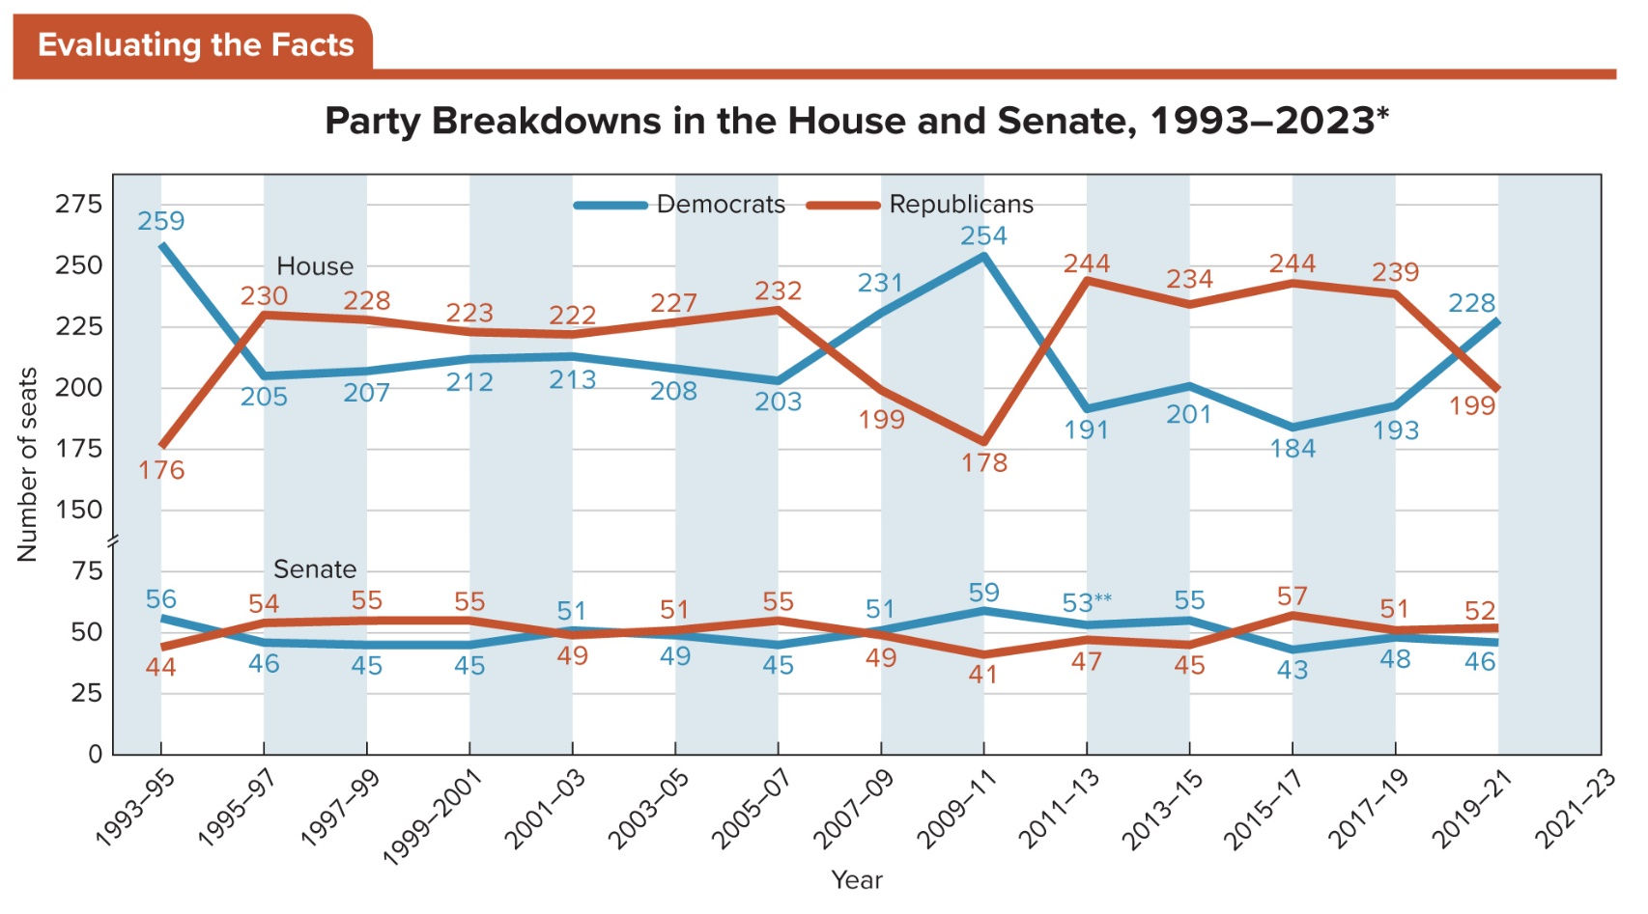
Figure 12.2 Party Representation Trends
* At the time of publication, runoff elections were scheduled for both U.S. Senate seats in Georgia.
Access the text alternative to slide image.

Slide 43
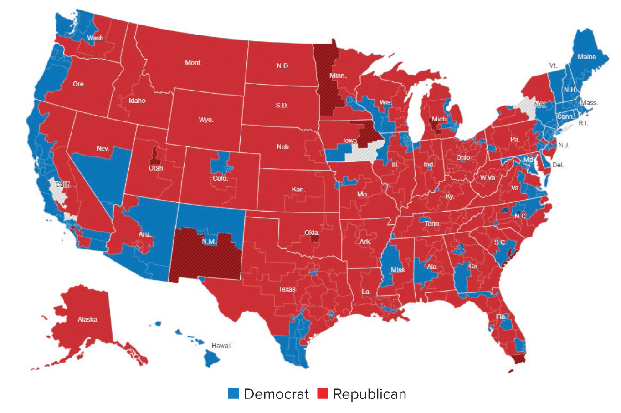
Figure 12.3 Party Representation in the House of Representatives, 2021 to 2023
Note: At time of publication, House races in the following districts had not yet been officially decided: CA-21; CA-25; IA-02; NY-01; NY-02; NY-11; NY-22; NY-24.
Access the text alternative to slide image.

Slide 44
Colleagues and Staff: Trading Votes and Information
Congressional colleagues provide cues for members of the House and the Senate in their decision making over whether to vote for a pending piece of legislation.
Members of Congress also engage in logrolling, the practice of trading votes between members.
In addition, House and Senate members rely on their staffs to inform their decision making on legislation.

Slide 45
Interest Groups: Influence Through Organization
Interest groups make their mark by:
Influencing congressional campaigns.
Providing information to members of Congress as they try to decide whether to vote for a particular piece of legislation.
Lobbying members of Congress to support or oppose legislation.

Slide 46
The President’s Effect on Decision Making
President determines whether to sign or to veto legislation that reaches his or her desk.
Often, before a bill reaches the signing stage, the president’s position on it carries enough influence to sway members of Congress, particularly members of his/her political party, to vote for or against the proposed legislation.
President can compel congressional action on an issue, such as health care.

Slide 47
Constituents: The Last Word
Most members of Congress want to be reelected, and representing constituents’ views is a major avenue to reelection to Congress.
Constituents can influence the legislative process by ensuring that their representatives in Congress represent their perspectives and policy interests.
Only a small percentage of voters, the attentive public, pay careful attention to the public policies being debated and to the votes cast.

Slide 48
The People and Their Elected Representatives
Members of Congress do not, demographically speaking, represent the American public at large.
Congress, especially the Senate, is older, whiter, more educated, and more likely to be male than the population as a whole.
Even though women and ethnic minorities are still underrepresented, Congress is more diverse today than at any other point in history.

Slide 49
Table 12.4 Demographic Characteristics of the 115th Congress Compared to the U.S. Population
DEMOGRAPHIC | HOUSE | SENATE | POPULATION
Democratic Party | 53% | 45% | 27%
Republican | 45% | 53% | 28%
Independent/ Unaffiliated | 0.2% | 2% | 42%
Average Age | 58 years | 63 years | 39 years
Male | 77% | 74% | 49%
Female | 23% | 26% | 51%
white | 78% | 93% | 60%
Black | 12% | 3% | 12%
Hispanic (any race) | 10% | 5% | 19%
Asian/Pacific Islands | 4% | 3% | 8%
Native American | 1% | 0% | .72%
Bachelor’s degree | 95% | 100% | 30%
Master’s degree | 23% | 18% | 9%
Law degree | 37% | 53% | >1%
Ph.D. | 5% | 4% | >1%
M.D. | 5% | 4% | >1%
Table having 4 columns summarizes demographic characteristics of the hundred and fifteenth Congress compared to the United States population. Column 1 notes party, average age, sex, race, and education. The column headers from 2 to 4 are marked as: House (percentage), senate (percentage), and population (percentage).
SOURCES: Jennifer E. Manning, Membership of the 114th Congress: A Profile (Washington, DC: Congressional Research Service), and U.S. Census Bureau, Population Estimates, and The Gallup Organization.

Slide 50
Women in Congress
Year 2018 saw a record number of women’s candidacies for Congress, and a particularly large number of Democratic women running against Republican House members.
Faced with these formidable challengers, large numbers of incumbent members decided to retire.
U.S. still lags behind many industrialized democracies in the proportion of women serving in the national legislature.

Slide 51
Racial and Ethnic Diversity in Congress
Similarly, African Americans have historically been underrepresented.
Only ten have served in the Senate.
Today, more African Americans serve in Congress than at any other point in history.
Latinx success still legs drastically behind their proportion of the population.
As women, African Americans, and ethnic minorities make up an increasing proportion of the eligibility pool, diversity in Congress is sure to grow.

Slide 52
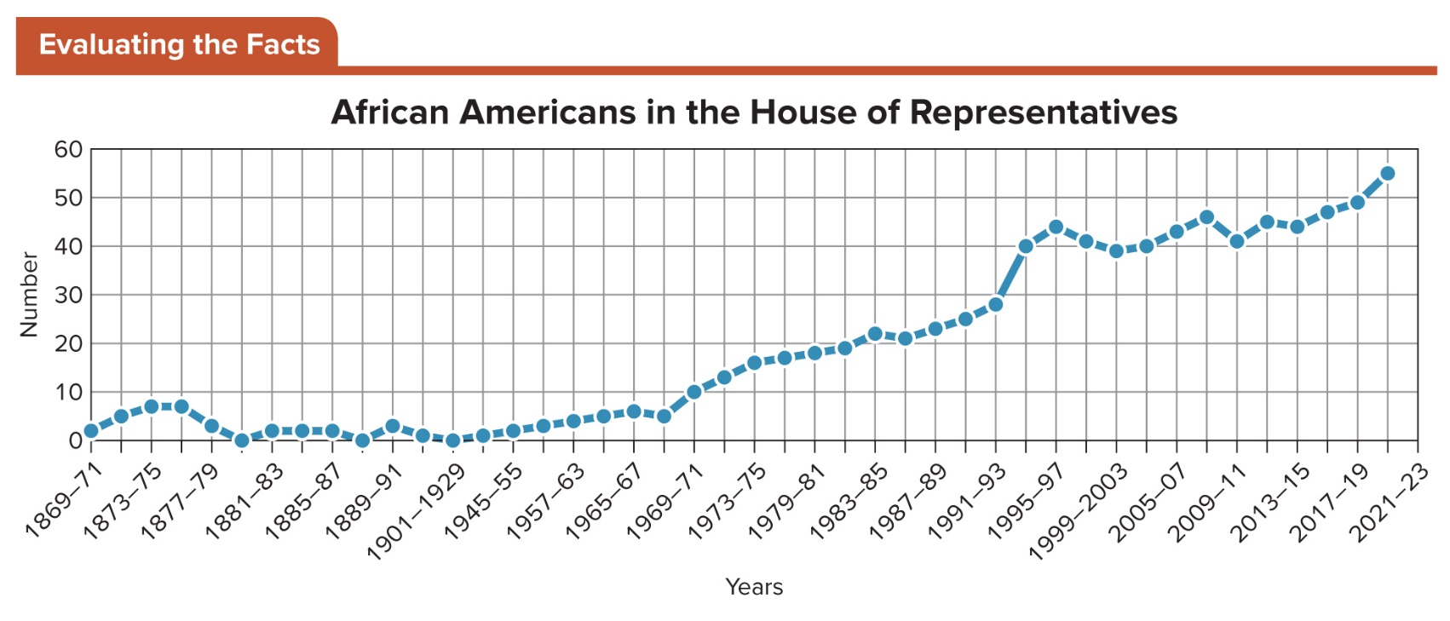
Figure 12.4 African Americans Elected to the House
As in the Senate, African Americans’ initial service in the House came about in the Reconstruction period. But the successes of that era were short lived, and the numbers of African Americans in Congress would not match those of the immediate post-Reconstruction period until after the civil rights movement of the 1960s.
Access the text alternative to slide image.

Slide 53
Review 1
Then—The framers granted to Congress both explicit powers and implied powers, by which the national government strengthened and broadened its authority.
Now—A much more demographically diverse but ideologically polarized Congress exercises wide powers, its decision making influenced by shifting constituencies in a changing nation.

Slide 54
Review 2
Next:
Will increased polarization of Republicans and Democrats in Congress continue to define the congressional agenda?
Will the competition between the president and Congress continue to define Congress as the weaker of the two branches?
Will the composition and policy making of Congress more broadly reflect the changing face of the United States?

Slide 55
End of Main Content
Copyright 2022 © McGraw Hill LLC. All rights reserved. No reproduction or distribution without the prior written consent of McGraw Hill LLC.

Slide 56
Accessibility Content: Text Alternatives for Images

Slide 57
Figure 12.1 The Legislative Process - Text Alternative
Return to parent-slide containing image.
The concept for legislative consideration is introduced in the House and in the Senate. Each assigns the bill to committee, and it is usually then referred to a subcommittee.
If the bill in the House makes it out of committee, the Rules Committee schedules debate, and floor action takes place.
If the bill in the Senate makes it out of committee, Senate leadership schedules debate, and floor action takes place.
Once the bill is approved in the House and the corresponding bill is approved in the Senate, if they are identical, they can move on to presidential approval. If there are differences, the bills go to a conference committee, which creates a conference bill, and floor action takes place once again.
Once the identical bill is approved in both houses, it moves to presidential approval. If the president approves, the bill becomes law. If the president vetoes the bill, the Senate may override the veto, in which case the bill becomes law. If the override is unsuccessful, the bill does not become law, and the legislative process starts again.
Return to parent-slide containing image.

Slide 58
Figure 12.2 Party Representation Trends - Text Alternative
Return to parent-slide containing images.
Line graphs illustrate party breakdowns in the House and Senate from 1991 to 2021. The data shows that the Republicans took control from Democrats in the house in 1995, losing it in 2007, regaining it in 20, and losing it in 2019. The largest exchange of seats took place in 1993, 2009, 2011, and 2019. In the Senate, Republicans to control from Democrats in 1995, maintained a virtual stalemate in 2001 two 2005, when they briefly took the lead. Democrats held fifty-nine Senate seats in 2009 but dropped from 55 to 43 in 2015, returning to a close balance of 48 to 52 Republican senators in 2019.
Return to parent-slide containing images.

Slide 59
Figure 12.3 Party Representation in the House of Representatives, 2021 to 2023 - Text Alternative
Return to parent-slide containing images.
This illustration of party representation by geographic area on the map of the United States shows blue (Democratic) coasts on the Pacific southern Florida, North Carolina, the middle Atlantic at New England, blue pockets in Georgia, Alabama, Mississippi, the southern tip of Texas, and all blue New Mexico and eastern half of Arizona, a blue southern half of Nevada, a blue western half of Minnesota and parts of Illinois and Iowa. Otherwise, a largely red (Republican) map of the Midwest, South and trans-Mississippi West is interspersed by small dots of blue
Return to parent-slide containing images.

Slide 60
Figure 12.4 African Americans Elected to the House - Text Alternative
Return to parent-slide containing images.
Horizontal axis represents year ranging from 1869 to 2023, while vertical axis represents number ranging from 0 to 70 in increments of 10.
The data is as follows:
Curve begins in 1869 to 1871 at 2 and ends in 2021 to 2023 at 60, showing increasing trend after 1969 to 1971 at 10.
Note: All data is approximate.
Return to parent-slide containing images.

